Slide 1
Important Dates
Assignment #1: Intro to Python – Opens 9/13
Research Proposal Instructions will be handed out. (9/13)
Assignment #2: Applying Analysis Techniques and Statistical Inference to Data: Opens 10/4
Assignment #1: Due 10/4
Students Research Proposals Due: (10/4)

Slide 2
Agenda
Guest Lecture: Ankit Saxena from GWU
Lecture 2: Data Science Process and Analytics Life Cycle
Lecture 4: Data Visualization
Lab:
Web Scraping
EDA
Go over GitHub, Anaconda, Jupyter, etc.

Slide 3
Lecture 4: Data Science Process and Data Analytics Life Cycle
Benjamin Harvey
The George Washington University
E-mail: bsharve@email.gw.edu

Slide 4
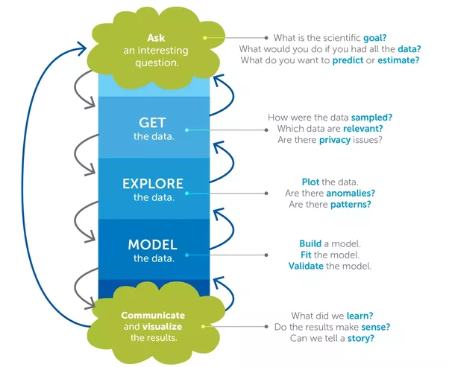
Data Science Process

Slide 5


Slide 6
Why Do I Care?
Data Science is just one aspect of Data Analytics
Gives insight into what you need to understand before about the organization and problem space before analytic implementation has started
Complete Data Scientist understands the following:
Enterprise (Business) Architecture/Systems Engineering
Cloud Computing
Big Data
Open Source Infrastructure
Data Science and Analytics
Business, Applications, Information, Math & Technology (e.g. Research DS vs. Enterprise DS)

Slide 7
Big Data Planning Considerations
Organization Prerequisites: Big Data Frameworks
Organization Perquisites: Big Data frameworks
Processing frameworks compute over the data in the system, either by reading from non-volatile storage or as it is ingested into the system. Computing over data is the process of extracting information and insight from large quantities of individual data points.
Types of Big Data frameworks include:
Batch-only frameworks
Stream-only frameworks
Hybrid frameworks

Slide 8
Big Data Planning Considerations
Technology and Data Procurement
The acquisition of Big Data solutions themselves can be economical, due to the availability of free and open-source (FOSS) platforms and tools and opportunities to leverage commodity hardware.
External data sources include government data sources and commercial data markets.

Slide 9
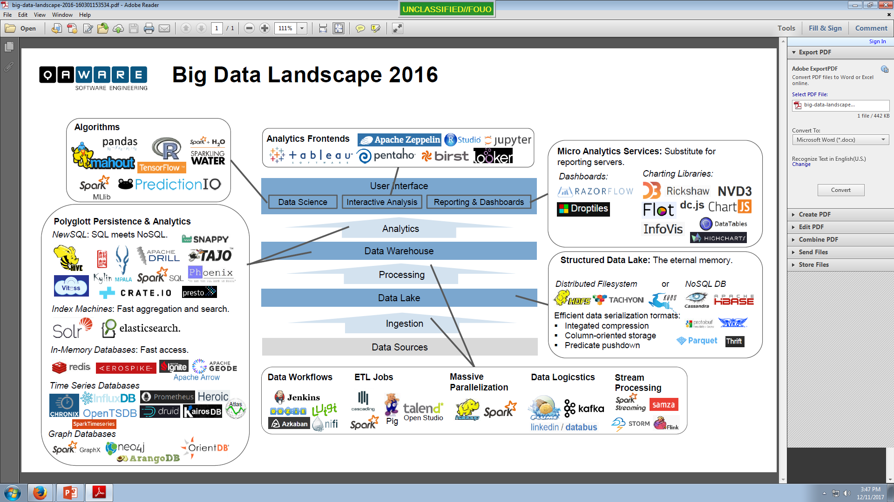
Data Analytics Life Cycle

Slide 10
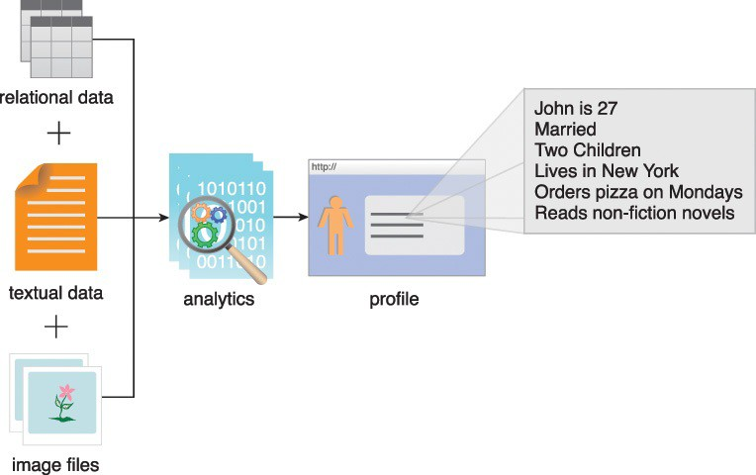
Planning Considerations - Data Privacy
Performing analytics on datasets can reveal confidential information about organizations or individuals.
Even analyzing separate datasets that contain seemingly benign data can reveal private information when the datasets are analyzed jointly
Addressing these privacy concerns requires an understanding of the nature of data being accumulated and relevant data privacy regulations, as well as special techniques for data tagging and anonymization.

Slide 11
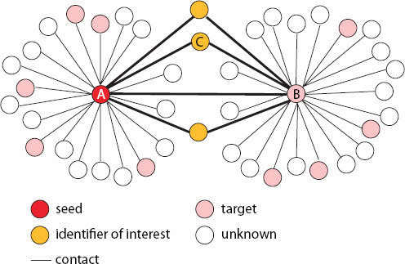
Joint Analytics and Privacy
FIGURE 3.1 A network of contacts among identifiers
https://www.nap.edu/read/19414/chapter/5#43

Slide 12
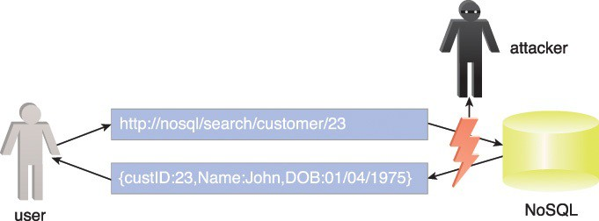
Security
Some of the components of Big Data solutions lack the robustness of traditional enterprise solution environments when it comes to access control and data security.
Securing Big Data involves ensuring that the data networks and repositories are sufficiently secured via authentication and authorization mechanisms (also based upon job role). E.g. SQL injection
Figure 3.2 NoSQL databases can be susceptible to network-based attacks.

Slide 13
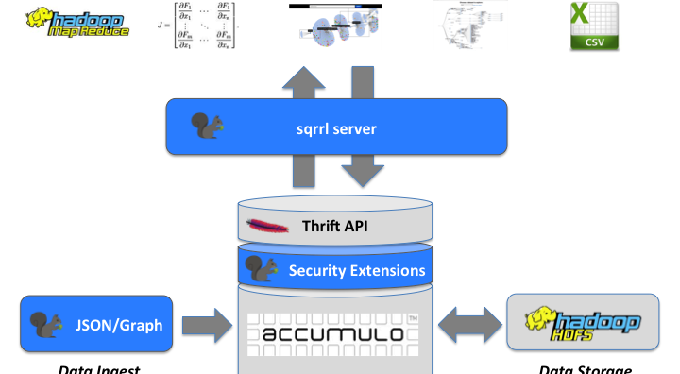


Data Security - Accumulo
Processing and Analytics
Security Layer
SOTF/Formatted Data

Slide 14

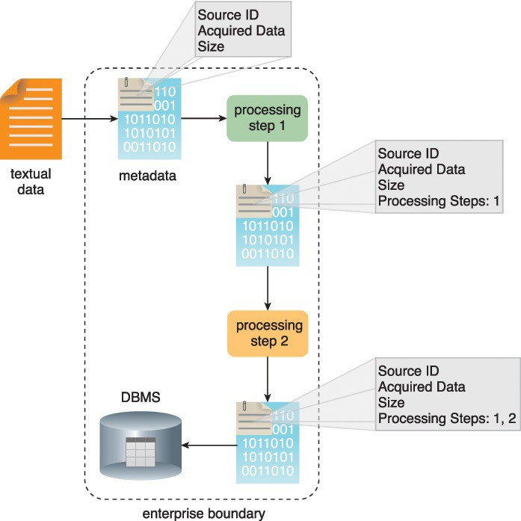
Adoption and Planning
Provenance
Provenance refers to information about the source of the data and how it has been processed.
Two aspects of provenance include:
Data Tracking and Tagging

Slide 15
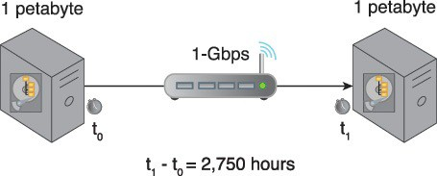
Big Data Planning Considerations
Limited Real-time Support
Dashboards and other applications that require streaming data and alerts often demand real-time or near-real-time data transmissions.
Many open source Big Data solutions and tools are batch-oriented; however, there is a new generation of real-time capable open source tools that have support for streaming data analysis.
Distinct Performance Challenges
Due to the volumes and temperatures of data, some Big Data solutions are required to process data in real-time and performance is often a concern.
Latency is the amount of time it takes to travel through the tube.
Bandwidth is how wide the tube is.
The amount of water flow will be your throughput
Figure 3.4 Transferring 1 PB of data via a 1-Gigabit LAN connection at 80% throughput will take approximately 2,750 hours
Notes:
Bandwidth- it refers to how wide the pipe is, not how fast. Latency: Latency is delay. For our purposes, it is the amount of time it takes a packet to travel from source to destination. Together, latency and bandwidth define the speed and capacity of a network. Throughput is the amount of data in a given amount of time.

Slide 16
Big Data Planning Considerations
Distinct Governance Requirements
Big Data solutions access data and generate data, all of which become assets of the business.
A governance framework is required to ensure that the data and the solution environment itself are regulated, standardized and evolved in a controlled manner.
Chief Data Officer - SSORs and ADSs and Data Quality
Examples of what a Big Data governance framework can encompass include:
standardization of how data is tagged and the metadata within the tags
policies that regulate the kind of external data that may be acquired
policies regarding the management of data privacy and data anonymization
policies for the archiving of data sources and analysis results
policies that establish guidelines for data cleansing and filtering

Slide 17
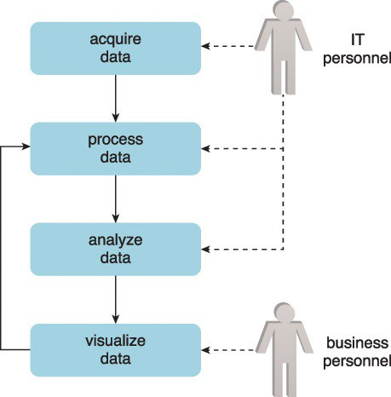
Big Data Planning Considerations
Distinct Analytic Methodology
A methodology will be required to control how data flows into and out of Big Data solutions.
DFaaS (Batch)
Pub/Sub (Warehouses)
It will need to consider how feedback loops can be established to enable the processed data to undergo repeated refinement.
“Human-in-the-loop”
Notes:
Evidence suggests that a variant of Pareto’s famous 80:20 leads to some of the most accurate machine learning systems to date, with 80% computer AI-driven, 19% human input, and 1 % unknown randomness to balance things out.
Human input can come in two different forms. A) Helping label the original dataset that will be fed into a machine learning model, and B) Helping correct inaccurate predictions that arise as the system goes live.
https://blog.algorithmia.com/machine-learning-with-human-in-the-loop/

Slide 18
Planning Considerations - Clouds
Clouds provide remote environments that can host IT infrastructure for large-scale storage and processing, among other things.
Common justifications for incorporating a cloud environment in support of a Big Data solution include:
inadequate in-house hardware resources
upfront capital investment for system procurement is not available
the project is to be isolated from the rest of the business so that existing business processes are not impacted (e.g. private cloud)
the Big Data initiative is a proof of concept
datasets that need to be processed are already cloud resident
the limits of available computing and storage resources used by an in-house Big Data solution are being reached
Notes:
Regardless of whether an organization is already cloud-enabled, the adoption of a Big Data environment may necessitate that some or all of that environment be hosted within a cloud.

Slide 19
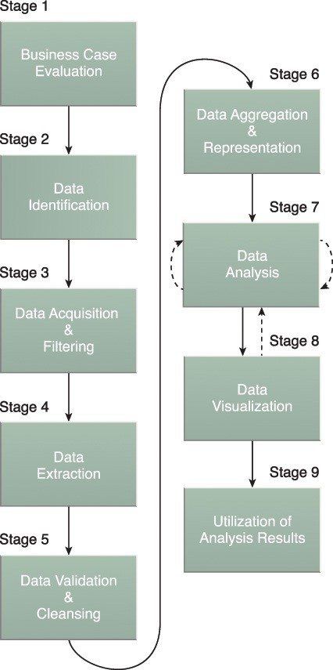
Big Data Analytics Lifecycle
Big Data analysis differs from traditional data analysis primarily due to the volume, velocity and variety characteristics of the data being processes.
To address the distinct requirements for performing analysis on Big Data, a step-by-step methodology is needed to organize the activities and tasks involved with acquiring, processing, analyzing and repurposing data:
Business Case Evaluation
Data Identification
Data Acquisition & Filtering
Data Extraction
Data Validation & Cleansing
Data Aggregation & Representation
Data Analysis
Data Visualization
Utilization of Analysis Results

Slide 20
Data Life Cycle
Validation and Cleansing
Extraction and Formatting/Visualization
Aggregation and Representation
Acquisition and Filtering

Slide 21
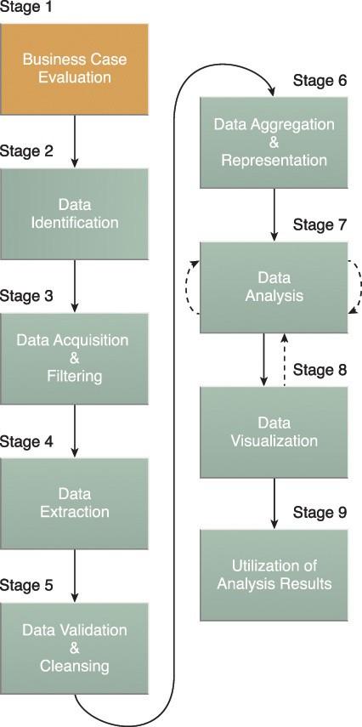
Business Case Evaluation
Each Big Data analytics lifecycle must begin with a well-defined business case that presents a clear understanding of the material processes and The Business questions needed to conduct the analysis and how it is aligned with the goals of the organization.
Case Evaluation stage requires that a business case be created, assessed and approved prior to proceeding with the actual hands-on analysis tasks (e.g. AVG).
An evaluation of a Big Data analytics business case helps decision-makers understand the business resources that will need to be utilized and which business challenges the analysis will tackle (e.g. Solutions Process).

Slide 22
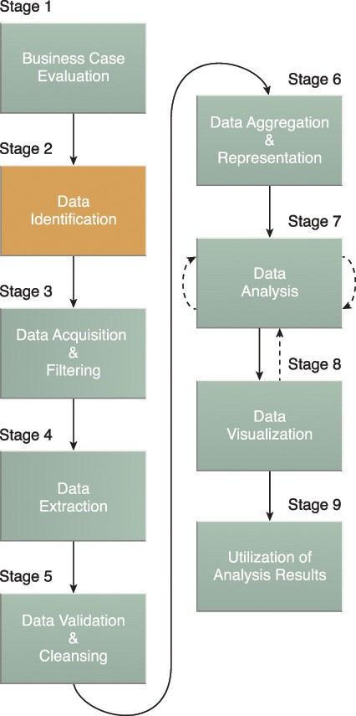
Data Identification
The Data Identification stage is dedicated to identifying the datasets required for the analysis project and their sources.
Identifying a wider variety of data sources may increase the probability of finding hidden patterns and correlations.
Depending on the business scope of the analysis project and nature of the business problems being addressed, the required datasets and their sources can be internal and/or external to the enterprise.
Notes:
For example, to provide insight, it can be beneficial to identify as many types of related data sources as possible, especially when it is unclear exactly what to look for.

Slide 23
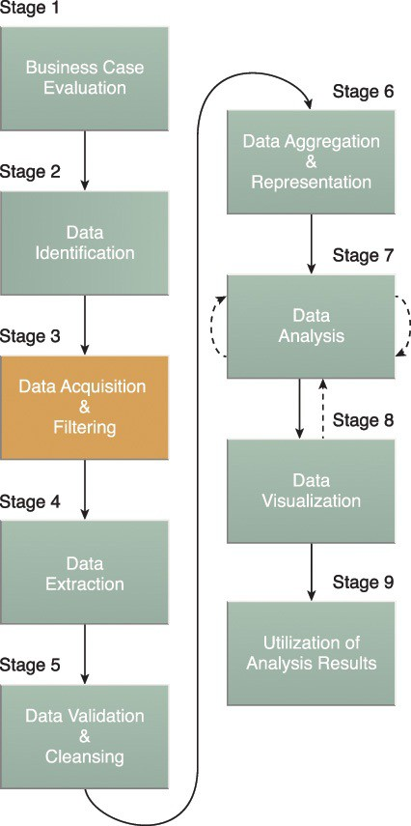
Data Acquisition & Filtering
During the Data Acquisition and Filtering stage is the gathering of data from all sources identified during the previous stage (Data Identification).
The acquired data is then subjected to automated filtering for the removal of corrupt data or data that has been deemed to have no value to the analysis objectives (e.g. NiFi).
Depending on the type of data source, data may come as a collection of files, such as data purchased from a third-party data provider, or may require API integration, such as with Twitter.
Notes:
In many cases, especially where external, unstructured data is concerned, some or most of the acquired data may be irrelevant (noise) and can be discarded as part of the filtering process.

Slide 24
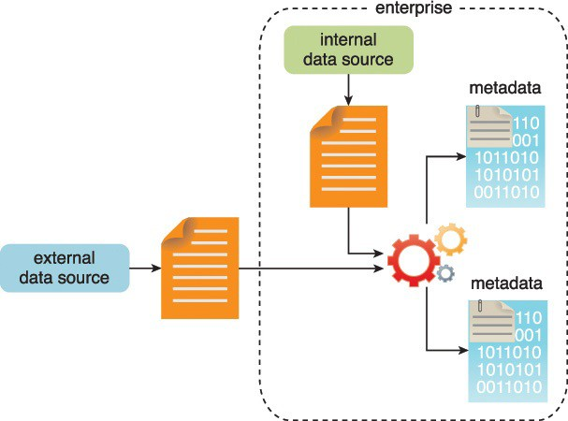
Data Acquisition & Filtering
Figure 3.10 Metadata is added to data from internal and external sources.
Notes:
It is vital that metadata be machine-readable and passed forward along subsequent analysis stages. This helps maintain data provenance throughout the Big Data analytics lifecycle, which helps to establish and preserve data accuracy and quality.
Examples of appended metadata include dataset size and structure, source information, date and time of creation or collection and language-specific information.

Slide 25

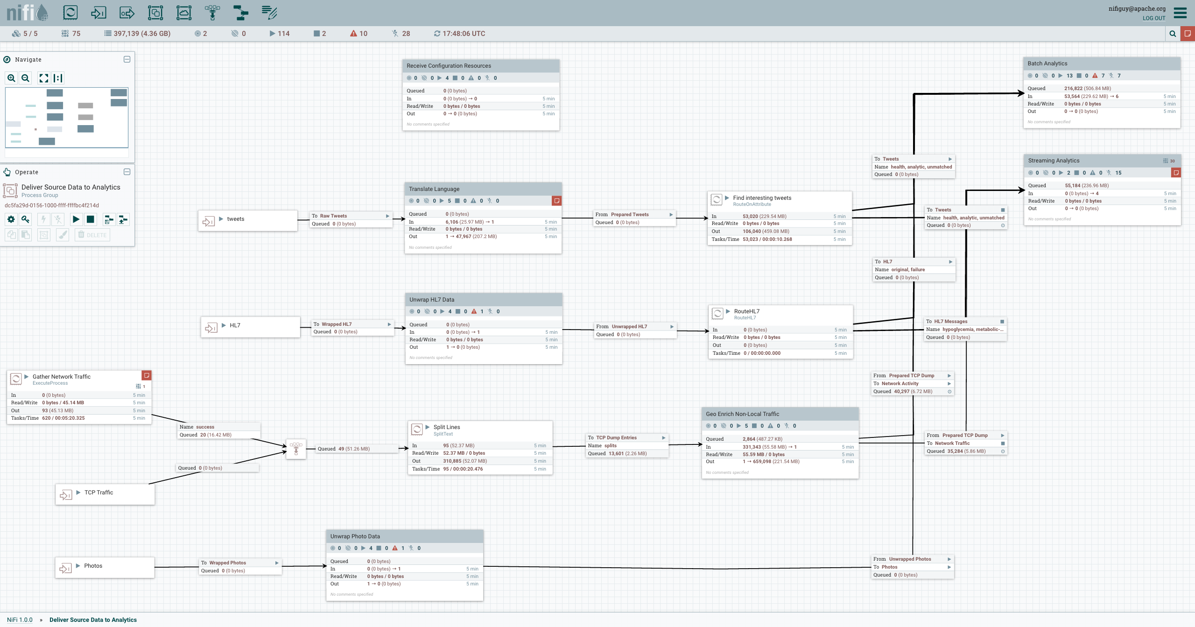
Data Acquisition and Filtering -NiFi
http://nifi.apache.org

Slide 26
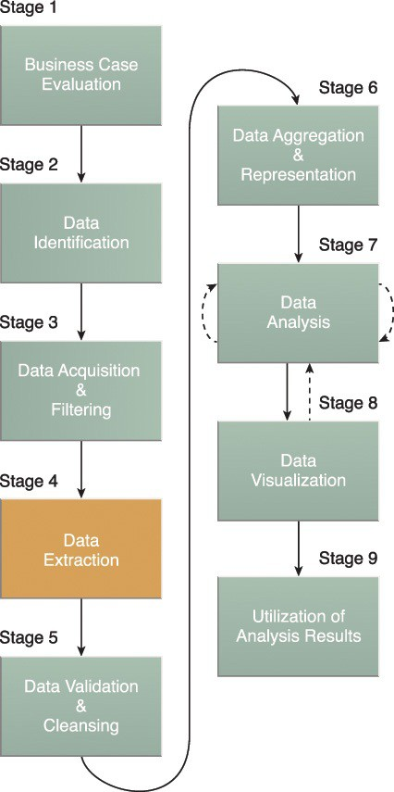
Data Extraction & Formatting
Some of the data identified as input for the analysis may arrive in a format incompatible with the Big Data solution.
The Data Extraction lifecycle stage is dedicated to extracting disparate data and transforming it into a format that the underlying Big Data solution can use for the purpose of the data analysis (e.g. Data Format Standards - SOTF).
The extent of extraction and transformation required depends on the types of analytics and capabilities of the Big Data solution
Notes:
For example, extracting the required fields from delimited textual data, such as with webserver log files, may not be necessary if the underlying Big Data solution can already directly process those files.

Slide 27
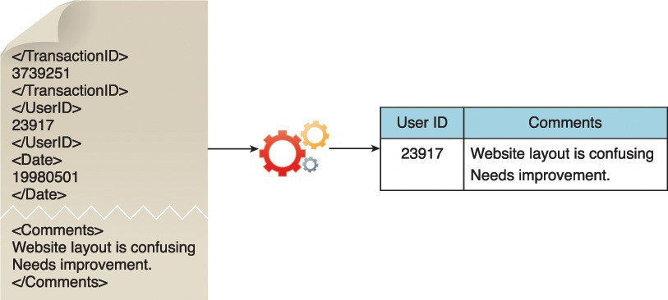
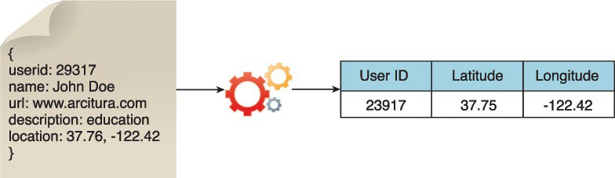
Data Extraction
Figure 3.12 illustrates the extraction of comments and a user ID embedded within an XML document without the need for further transformation.
Figure 3.13 demonstrates the extraction of the latitude and longitude coordinates of a user from a single JSON field.

Slide 28
A Prototype Spatial Object Transfer Format (SOTF)
SOTF supports multiple inheritance of feature types
SOTF supports light-weight, binary feature relationships
SOTF it was originally designed to handle complex, structured geospatial data;
it does not support methods and behaviour.
SOTF has an object-oriented schema with:
features and feature types
properties and data types
SOTF supports multiple geometric properties per feature
SOTF supports both spatial and aspatial feature types
Designed to work with both [object-]relational and object-oriented data stores
An SOTF dataset always includes an explicit schema
To support export of an SOTF dataset a data store
should provide feature identifiers that persist between exports
may provide ability to retain a previous state

Slide 29
A Prototype Spatial Object Transfer Format (SOTF)
Data supplier
Data consumer
dataset
Data supplier (with pre-defined ‘tile’ structure)
Pre-generated, stock-piled, set of SOTF objects
Data consumer combines SOTF objects

Slide 30
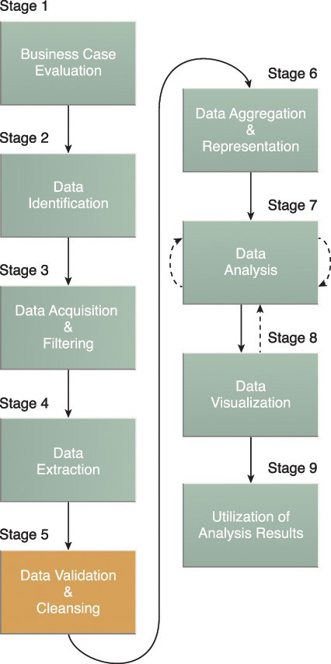
Data Validation & Cleaning
Invalid data can skew and falsify analysis results. Unlike traditional enterprise data, where the data structure is pre-defined and data is pre-validated, data input into Big Data analyses can be unstructured without any indication of validity.
This stage is dedicated to establishing often complex validation rules and removing any known invalid data.
Big Data solutions often receive redundant data across different datasets. This redundancy can be exploited to explore interconnected datasets in order to assemble validation parameters and fill in missing valid data.

Slide 31
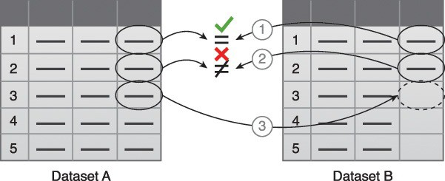
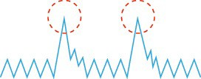
Data Validation & Cleaning
Figure 3.15 Data validation can be used to examine interconnected datasets in order to fill in missing valid data.
Abnormal/Outlier
Statically Significant
Figure 3.16 The presence of invalid data is resulting in spikes. Although the data appears abnormal, it may be indicative of a new pattern.

Slide 32
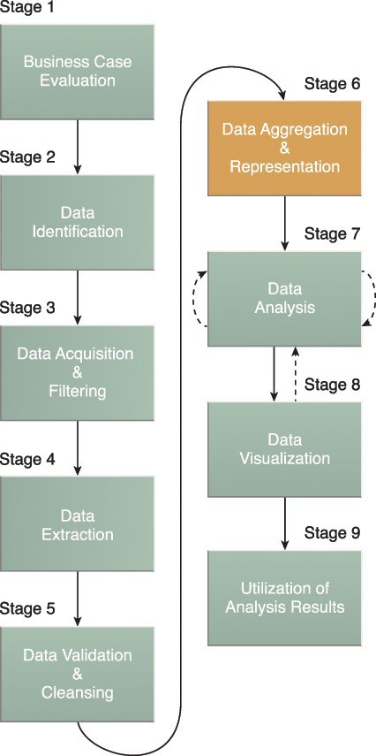
Data Aggregation & Representation
The Data Aggregation and Representation stage is dedicated to integrating multiple datasets together to arrive at a unified view.
Performing this stage can become complicated because of differences in:
Data Structure – Although the data format may be the same, the data model may be different.
Semantics – A value that is labeled differently in two different datasets may mean the same thing, for example “surname” and “last name.”
Notes:
Data may be spread across multiple datasets, requiring that datasets be joined together via common fields, for example date or ID. In other cases, the same data fields may appear in multiple datasets, such as date of birth. Either way, a method of data reconciliation is required or the dataset representing the correct value needs to be determined.

Slide 33
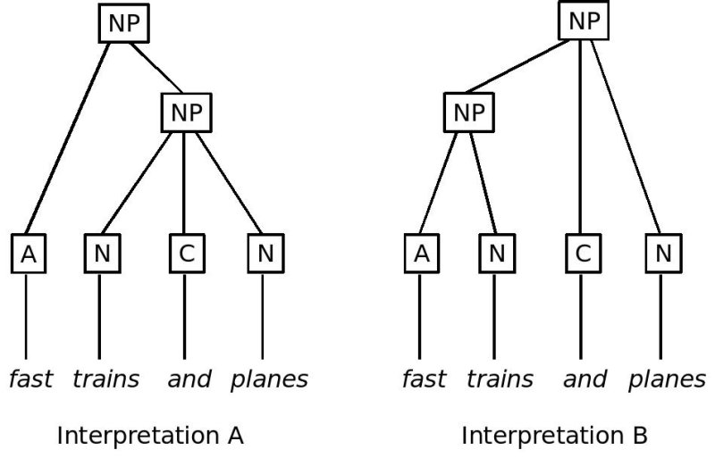
Data Aggregation & Representation

Slide 34

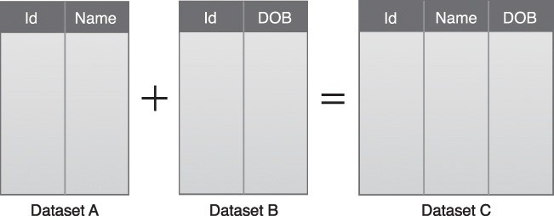
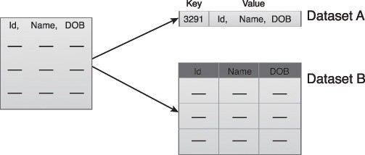
Data Aggregation & Representation
Figure 3.18 A simple example of data aggregation where two datasets are aggregated together using the Id field.
Figure 3.19 Dataset A and B can be combined to create a standardized data structure with a Big Data solution.

Slide 35
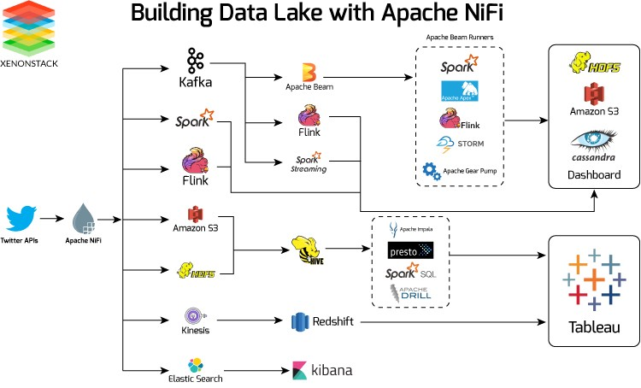
Building a Data Lake with NiFi
Xenonstack.com

Slide 36
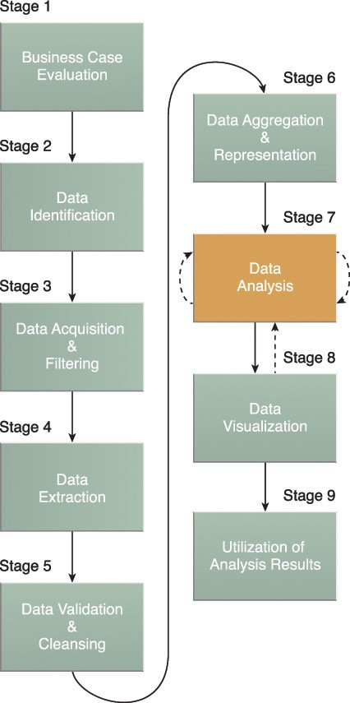
Data Analysis
The Data Analysis stage is dedicated to carrying out the actual analysis task, which typically involves one or more types of analytics.
This stage can be iterative in nature, especially if the data analysis is exploratory, in which case analysis is repeated until the appropriate pattern or correlation is uncovered.
The Exploratory Data Analysis (EDA) approach will be explained shortly, along with confirmatory analysis.
Type examples:
querying a dataset to compute an aggregation for comparison
combining data mining and complex statistical analysis techniques to discover patterns and anomalies or to generate a statistical or mathematical model to depict relationships between variables.
E/CDA
Notes:
Depending on the type of analytic result required, this stage can be as simple as querying a dataset to compute an aggregation for comparison. On the other hand, it can be as challenging as combining data mining and complex statistical analysis techniques to discover patterns and anomalies or to generate a statistical or mathematical model to depict relationships between variables.

Slide 37
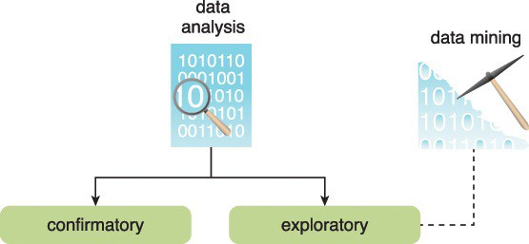
Data Analysis
Data analysis can be classified as confirmatory analysis or exploratory analysis. The latter of which is linked to data mining
Data mining is the computing process of discovering patterns in large data sets involving methods at the intersection of machine learning, statistics, and database systems.
Confirmatory Data Analysis (CDA) is a deductive approach where the cause of the phenomenon being investigated is proposed beforehand. The proposed cause or assumption is called a hypothesis.
Exploratory Data Analysis (EDA) is an inductive approach that is closely associated with data mining. No hypothesis or predetermined assumptions are generated. Instead, the data is explored through analysis to develop an understanding of the cause of the phenomenon.
Figure 3.21 Data analysis can be confirmatory or exploratory analysis.
Notes:
Deductive reasoning starts with a general theory, statement, or hypothesis and then works its way down to a conclusion based on evidence. Inductive reasoning starts with a small observation or question and works it's way to a theory by examining the related issues.

Slide 38
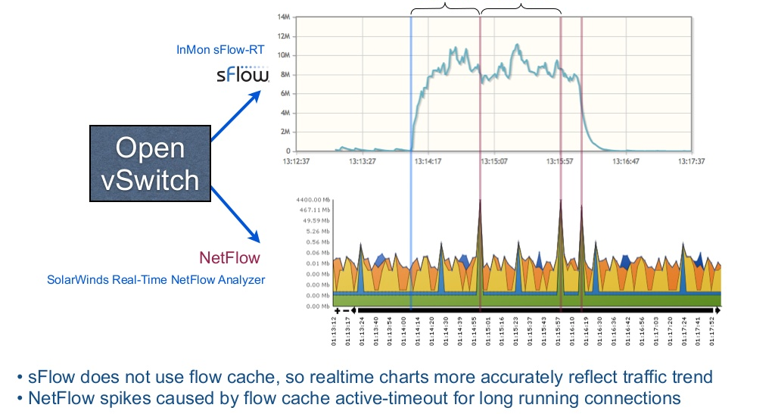
EDA and CDA
Just explore the data to see what is there.
Why this surge in netflow?
Source: sflow.com

Slide 39
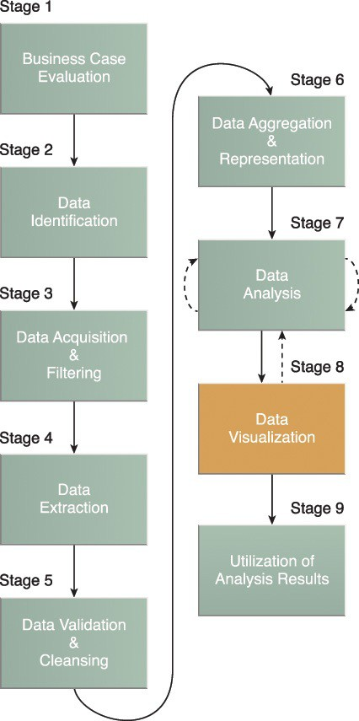
Data Visualization
The Data Visualization stage is dedicated to using data visualization techniques and tools to graphically communicate, represent and interpret the analysis results for effective interpretation by business users.
The Data Visualization stage is dedicated to using data visualization techniques and tools to graphically communicate the analysis results for effective interpretation by business users.
The results of completing the Data Visualization stage provide users with the ability to perform visual analysis, allowing for the discovery of answers to questions that users have not yet even formulated.
Notes:
The ability to analyze massive amounts of data and find useful insights carries little value if the only ones that can interpret the results are the analysts.
Business users need to be able to understand the results in order to obtain value from the analysis and subsequently have the ability to provide feedback

Slide 40
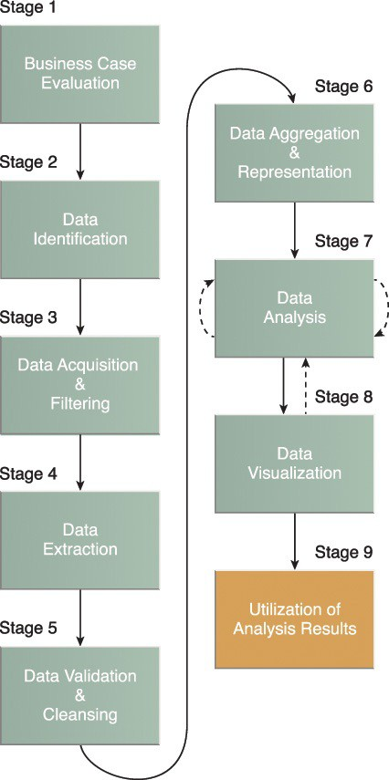
Utilization of Analysis Results
Subsequent to analysis results being made available to business users to support business decision-making, such as via dashboards, there may be further opportunities to utilize the analysis results.
The Utilization of Analysis Results stage is dedicated to determining how and where processed analysis data can be further leveraged.
Depending on the nature of the analysis problems being addressed, it is possible for the analysis results to produce “models” that encapsulate new insights and understandings about the nature of the patterns and relationships that exist within the data that was analyzed.
Notes:
A model may look like a mathematical equation or a set of rules. Models can be used to improve business process logic and application system logic, and they can form the basis of a new system or software program.

Slide 41
Select One of the Use Cases Below to answer your questions above.
1. Log Analytics in Financial Services
Banks use regular financial risk model calculations across all of their lines of business to determine their overall risk profile. Banks' IT teams run these calculations continuously to ensure that they comply with rules and that liquidity and cash balances are adequate. In order to sufficiently analyze and monitor application performance in real-time to ensure a near 100% service level requirement for these critical applications, banks can depend on open source log analytics solutions.
2. E-Commerce
A system-wide logging infrastructure combined with log analytics is a powerful way to improve operational performance in IT and business. By analyzing event logs and system metrics that track the performance of IT systems and user logs that capture the behavior of users who interact with e-commerce sites, retailers can gather data and discover insights leading to more agile operations, improved competitive advantage, and increased site revenue.
3. Market Research
Market research is a very important component of today’s business strategy. Market research techniques typically encompass the analysis of data to gain insight or to support decision making. However, many market research firms have not improved their market research collection and analysis processes for years. In addition, both the amount of data and the number of data sources have increased exponentially in recent years. Thus, leveraging big data analytics solutions and scalable data processing techniques allows these firms to gather valuable takeaways and insights that could immensely benefit their subscribers.
4. Precision Agriculture
Agriculture has molded human history for centuries. Agricultural technology advancements have made collecting and storing data easy; but what about processing and analyzing this data to support productivity? How do we process and obtain information from all this data, which keeps growing in real-time? Combining search engines, big data, and analytics, we now have a method to tie agricultural data together, making agriculture an exact science, saving costs, and increasing productivity.
5. Precision Medicine
The scale of genomics information being collected is enormous. Today’s healthcare organizations and research institutes struggle with processing and extracting value out of the increasing deluge of genomics data triggered by the decreasing costs of genomics data sequencing. These organizations have increasingly been relying on big data analytics applications to ingest genomics data, physician notes, and medical research information in order to improve patient health, alleviate future health risks, and discover cures for diseases.

